Slide 1

Reservoir Engineering I
University of Basrah
Collage of Engineering / Petroleum Engineering Department
3rd year
Fall Semester 2017
By: Ahmed Al Alwan
WELCOME
اهلا وسهلا

Slide 2
Course materials and text books
Ahmed, Tarek 1964
Reservoir Engineering Handbook/4th eddition
B.C. Craft and M.F. Hawkings
Applied Petroleum Reservoir Engineering / 2nd Eddition
L. P. Dake
Fundamental of Reservoir Engineering
Other useful books & articles

Slide 3
Group work
Make groups of 3 or 4 students and try to contact each other to contribute both in the REPORT proplems solution and presentations. You will be asked to submit weekly or monthly report of problem solution.

Slide 4



Remember all time
Quiet zone
Silent iphones and electronic devices
Raise your hand and feel free to ask questions (no hisitation)
Early showing up
Voting democracy (not all the time)
Group work
FT 10 Minutes
Campusnet Group (Telegram or WhatsApp).

Slide 5
Lecture-1 outlines
Phase Behavior
Reservoir-Fluid Properties
Gas Properties
Boyle’s law
Charle’s law
Avogadro’s law
Equation of state
Dalton’s law
Compressibility factor (z-factor)

Slide 6
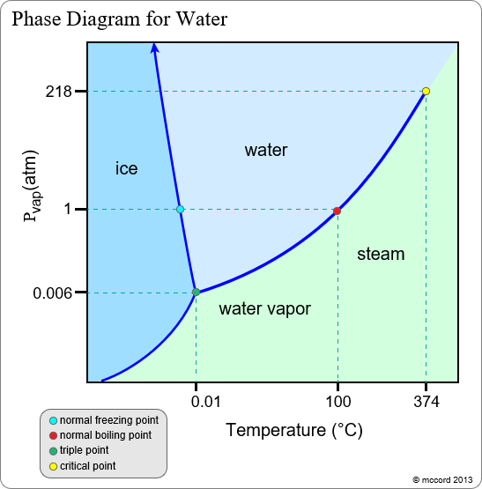
Review of Basic Phase Behavior
A phase is defined as any homogeneous part of a system that is physically distinct and separated from other parts of the system by definite boundaries.
Example of H2O (water)
Solid Phase (ice)
Liquid Phase (water)
Gas (vapor) Phase

Slide 7
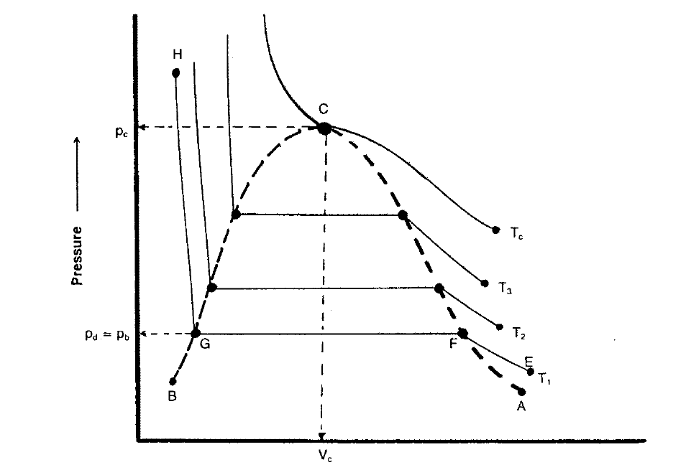
Single-Component Systems
Hydrocarbon systems found in petroleum reservoirs are known to display multi-phase behavior over wide ranges of pressure and temperatures.
The most important phase which occur in petroleum reservoirs are:-
Liquid Phase (crude oils or condensates)
Gas Phase (natural gas)
IMPORTANT
Increase the pressure at T1 from E to F
where liquid starts to condense at pd
dew-point pressure point F
From F to G tow-phase are existed
Point G is the bubble-point
The same happens for T2, T3 ....
No more tow-phase over point C

Slide 8
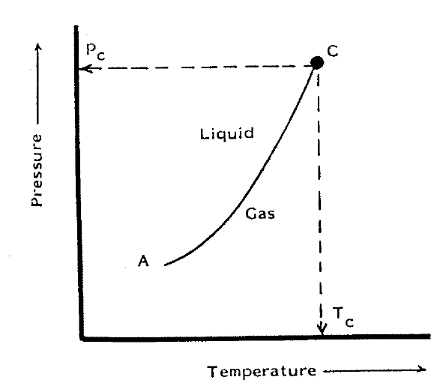
Single-Component Systems
Single-component P-T diagram

Slide 9
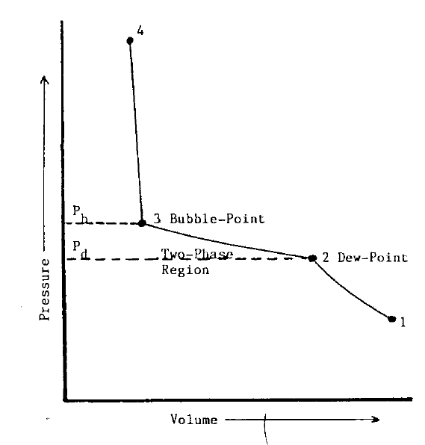
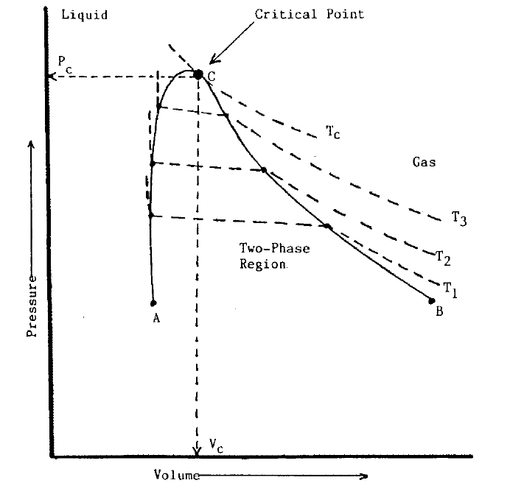
Tow-Component (Binary) Systems

Slide 10
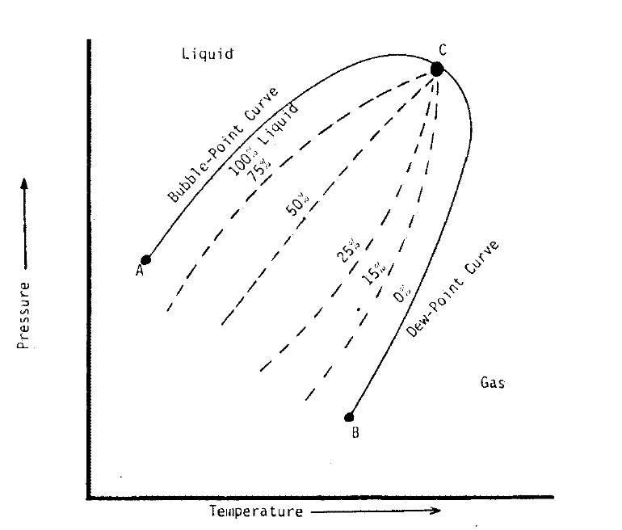
Tow-Component (Binary) Systems

Slide 11
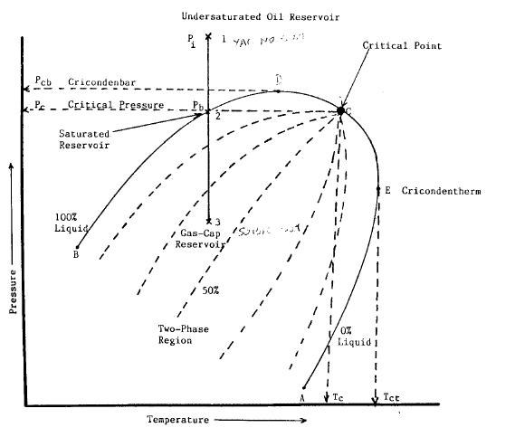
Multi-Component Systems
Cricondentherm Tct
Maximum T above which liquid cannot be
formed regardless of pressure
Cricondenbar Pcp
Maximum P above which no gas can be
formed regardless of temperature
Critical point
Phase envelope (two phase reqion)
Quality lines
Bubble point curve
Dew point curve
Oil reservoir T< Tc
Gas reservoir T> Tc

Slide 12
Oil reservoirs
Undersaturated oil res.
Saturated reservoir
Gas-cap reservoir

Slide 13
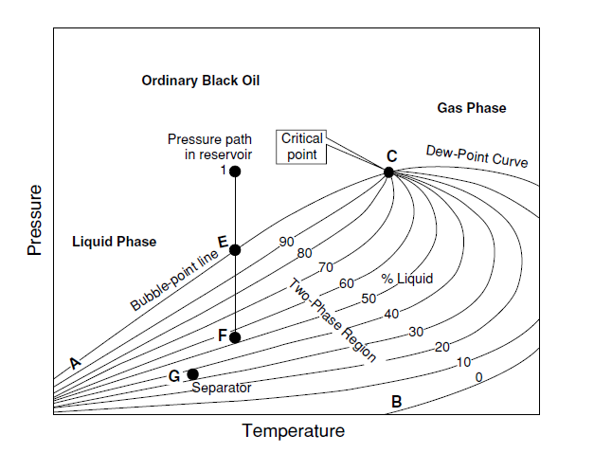
Oil reservoirs – Ordinary black oil
Approximately equally spaced quality lines

Slide 14
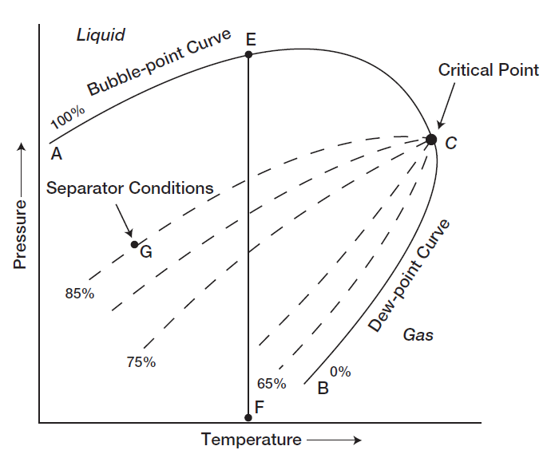
Oil reservoirs – low shrinkage crude oil

Slide 15
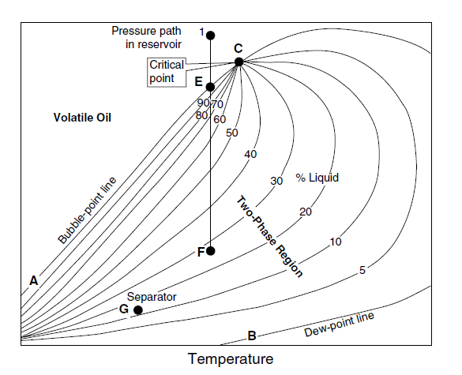
Oil reservoirs – High shrinkage voletile crude oil

Slide 16
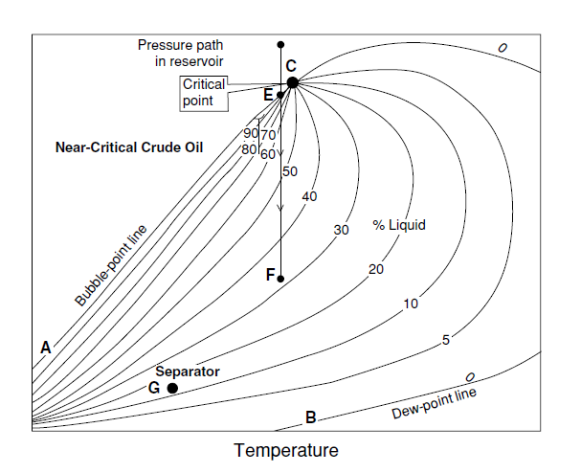
Oil reservoirs – Near critical crude oil

Slide 17
Gas reservoirs
Retrograde gas-condensate
Near-critical gas-condensate
Wet gas
Dry gas

Slide 18
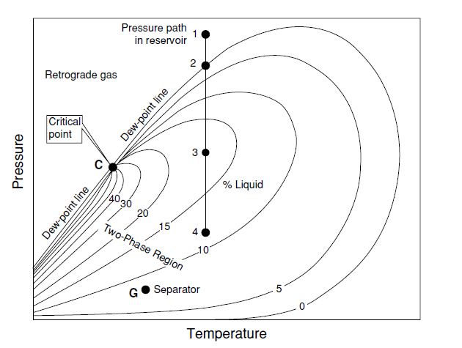
Gas reservoirs Retrograde gas-condensate
Reservoir temperature lies between Tc and Tct

Slide 19
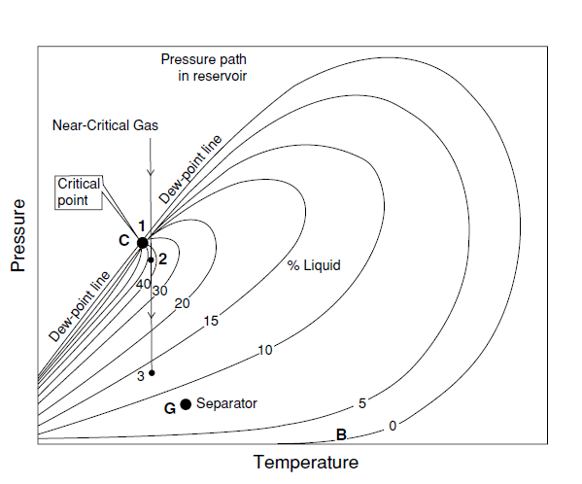
Gas reservoirs Near-critical gas-condensate

Slide 20
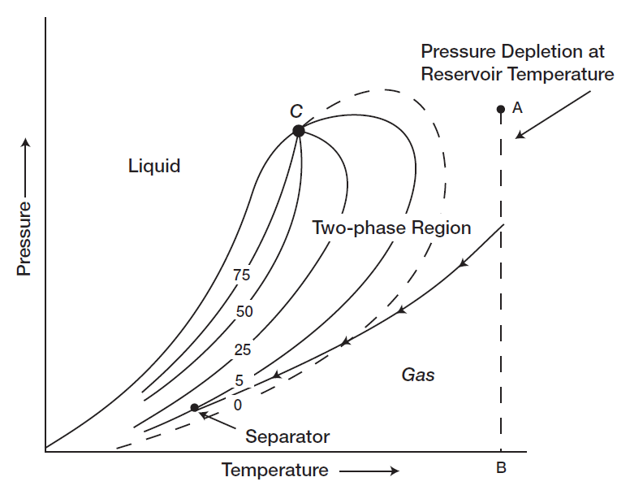
Gas reservoirs Wet gas

Slide 21
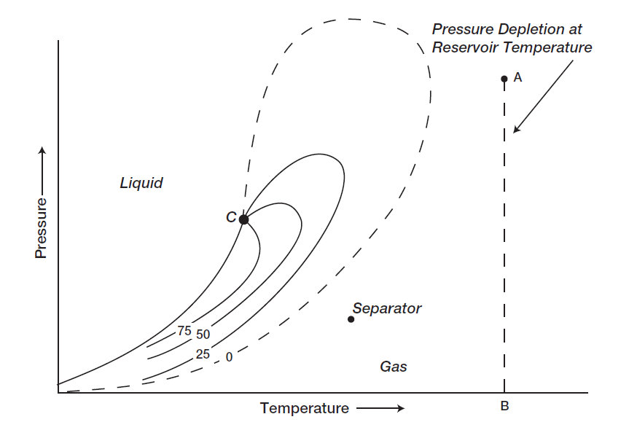
Gas reservoirs Dry gas

Slide 22
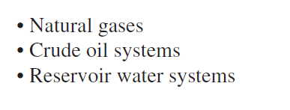
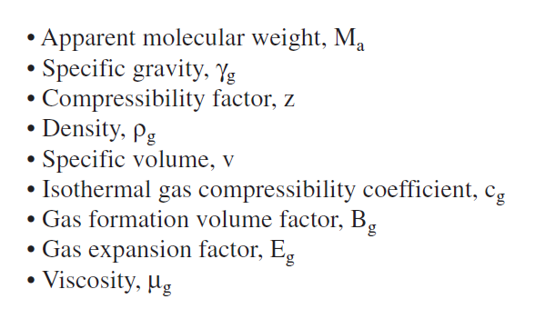
Reservoir-Fluid Properties
The PVT Analyses for gas

Slide 23
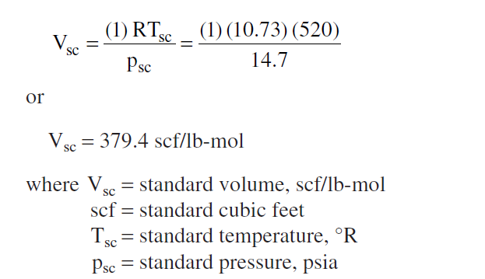
Standard Volume
The volume occupied by 1 Ib-mole of gas at standard conditions 14.7 psi and 60 F

Slide 24
General Gas Properties
Hemogeneous fluids of low density and low viscosity.
Independent shape and volume, but expand to fill completely the vessel in which they are contained.
The molcules are farther apart than in liquids.
Any change in pressure has a much greater effect on the density of a gas than of a liquid.
Ideal gas properties
The volume occupied by the molecules is insignificant with respect to the volume occupied by the gas.
There are no attractive or repulsive forces between the molecules or between molecules and the walls of the container.
All collisions of molecules are perfectly elastic, that is, there is no loss of internal energy upon collision.

Slide 25
Boyle’s Equation
The volume of an ideal gas is inversely propotional to pressure for a given mass of gas at constant temperature.
P: is the pressure psi
V: volume ft^3

Slide 26
Charle’s Equation
The volume of an ideal gas is directly propotional to temperature for a given mass of gas at constant pressure.
T: is the temperature F, or R
V: volume ft^3

Slide 27
Avogadro’s Law
Under the same conditions of temperature and pressure, equal volumes of all ideal gases contain the same number of molecules.
or
At a given temperature and pressure one molecular weight of any ideal gas occupies the same volume as one molecular weight of any ideal gas.
There are 2.73x10^26 molecules per pound mole of ideal gas.

Slide 28
Equation of State for an Ideal Gas
For a given mass of gas at stage-1 of volume V1, pressure P1, and temperature T1. If there will be a change to stage-2 of volume V2, pressure P2 and constant temperature. Boyle’s equation will be:-
In the case of change stage-1 to stage-2 of volume V2, temperature T2 and constant pressure. Charle’s law will be:-
Eliminating of volume V gives:-
or

Slide 29
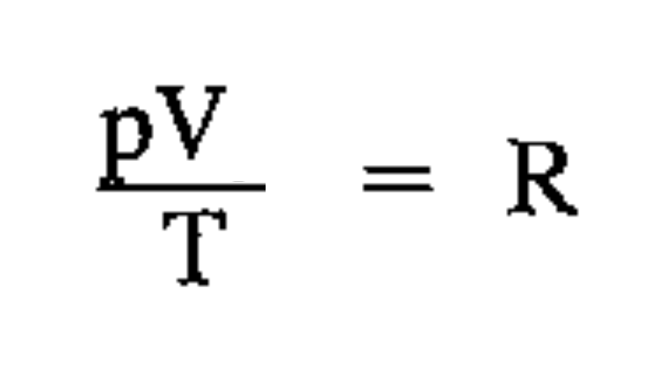
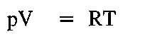
Equation of State for an Ideal Gas
From the previous
or
Where R is the universal gas constant
The volume V is the volume of one molecular weight of the gas, the molar volume. For n moles of ideal gas the equation will be :-
Which is called ideal gas law, general gas law, the perfect gas law
It can be also written as:-
Where m is mass and v is the volume of one unit of mass, or the specific volume

Slide 30

Equation of State for an Ideal Gas
Where:-
P: absolute pressure (psi)
V: volume (ft^3)
n: number of moles (Ib.mole)
T: Temperature (R)
R: the universal gas constant, which for the above units has the value of
(10.730 psi.ft^3/Ib.mole R)
m: weight of gas (Ib)
M: molecular weight (Ib/Ib.mole)

Slide 31
Equation of State for an Ideal Gas
Example-1: three pounds of n-butane are placed in a vessel at 120F and 60psi. Calculate the volume and the density of the gas assuming an ideal gas behavior given the molar weight of the n-butane is 58.123.
Example-2: calculate the mass and the density of methane gas contained at 1000psi and 68F in a cylinder with volume of 3.20 ft^3. Assume that methane is an ideal gas of molecular weight 16.04 Ib/Ib.mole.
For the report
Problem-1: Derive the equation of state (ideal gas law) from the kenetic theory of gasses.

Slide 32

Dalton’s Law
The total pressure exerted by a mixture of gases is equal to the sum of pressures exerted by its components. The pressure exerted by each of the component gases is known as the partial pressure.
Where: yi is the mole fraction of the components in the gas mixture.
Apparent molecular weight.
Ma: apparent molecular weight
Mi: molecular weight of the component
yi: is the mole fraction of the component

Slide 33
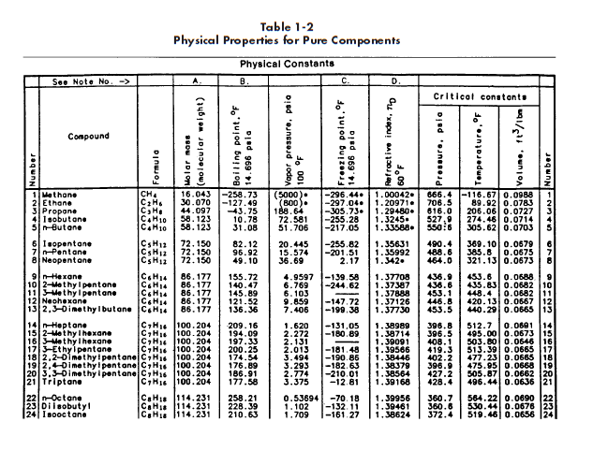
Remember to change the temperature unit from F to R

Slide 34
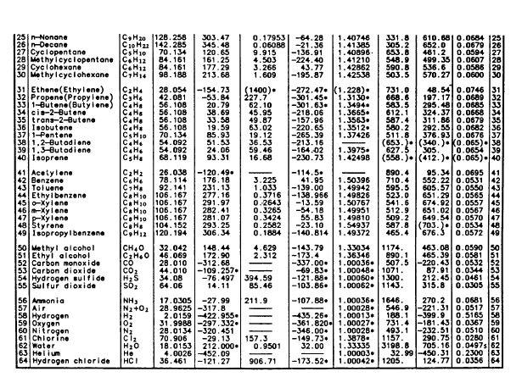

Slide 35
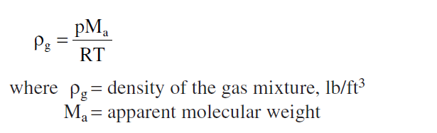
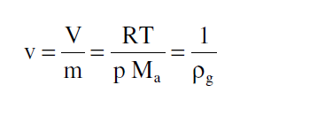
Density
Specific Volume

Slide 36
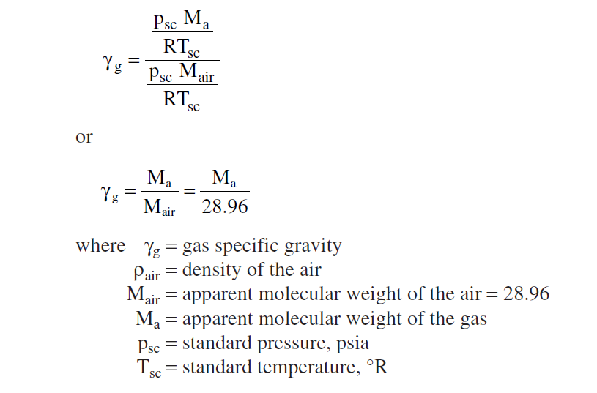
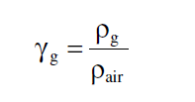
Specific Gravity

Slide 37
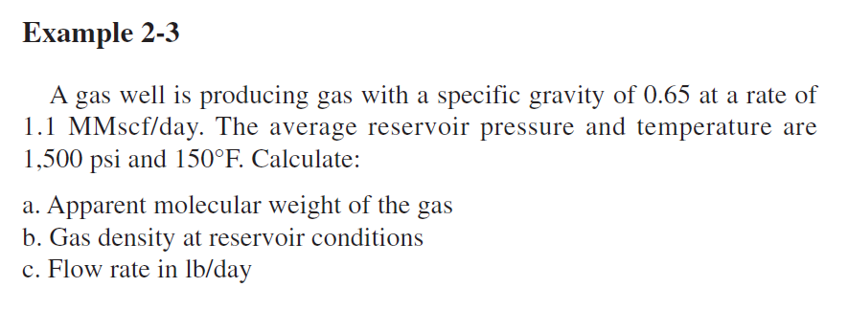

Slide 38
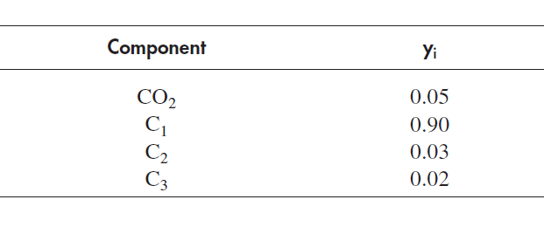
Example: A gas well producing a natural gas with following compositions:
Calculate:-
Apparent molecular weight
Specific gravity
Gas density at 2000psi and 150F
Specific volume at 2000psi and 150F

Slide 39
Problem-2 for the report
Problem-3 for the report

Slide 40

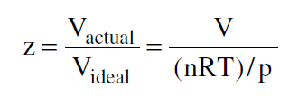
Compressibility z-factor, behavior of Real gases
Equation of state-real gases
Where z is the gas compressibility factor which is dimentionless quantity and is define as the ratio of the actual volume on n-mole of gas at T and p to the ideal volume of the same number of moles at the same T and P.
Z=1 for ideal gas
z≠1 for real gas

Slide 41
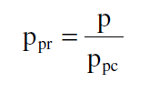
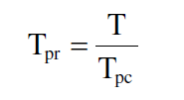
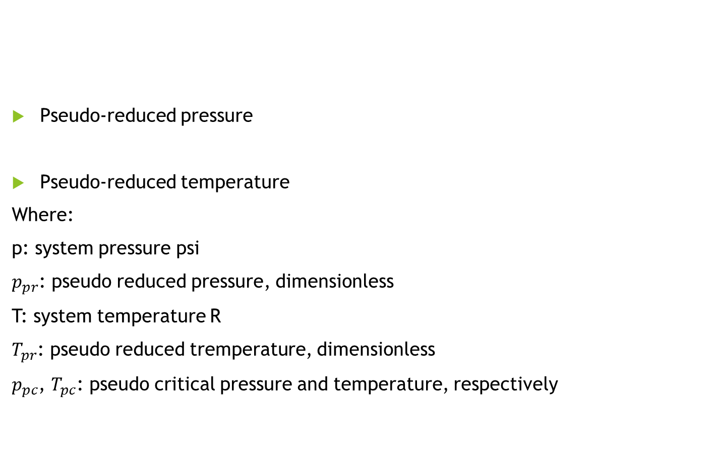
Determination of z-factor,
Pseudo-reduced pressure
Pseudo-reduced temperature
Where:
p: system pressure psi
$p_{pr}$: pseudo reduced pressure, dimensionless
T: system temperature R
$T_{pr}$: pseudo reduced tremperature, dimensionless
$p_{pc}$, $T_{pc}$: pseudo critical pressure and temperature, respectively

Slide 42


Determination of z-factor,
There are two ways of finding the Pseudo critical pressure and temperature
1- molar fraction components
Then using Standing-Kazz chart to find the z-factor as shown in the figure

Slide 43
Remember to change the temperature unit from F to R

Slide 45
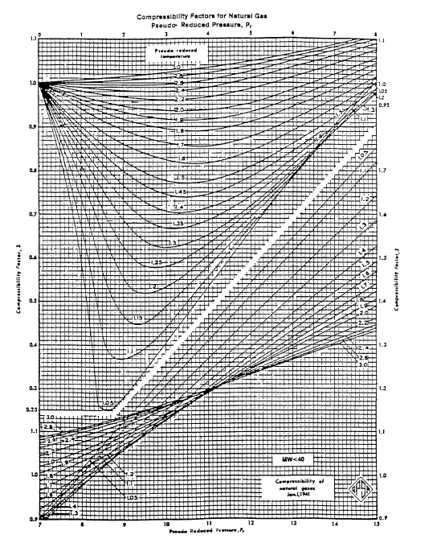

Slide 46
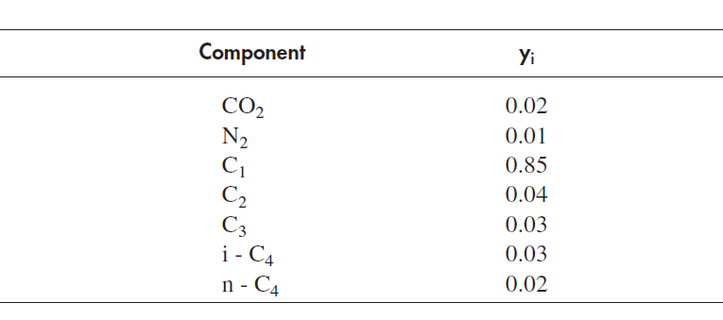
Example: A gas reservoir has the following gas composition, the initial reservoir pressure and temperature are 3000psi and 180F. Calculate the gas compressibility factor under the reservoir conditions.

Slide 47
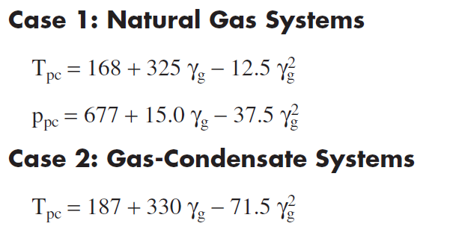

Determination of z-factor,
The second way of finding the Pseudo critical pressure and temperature
2- from the specific gravity

Slide 48
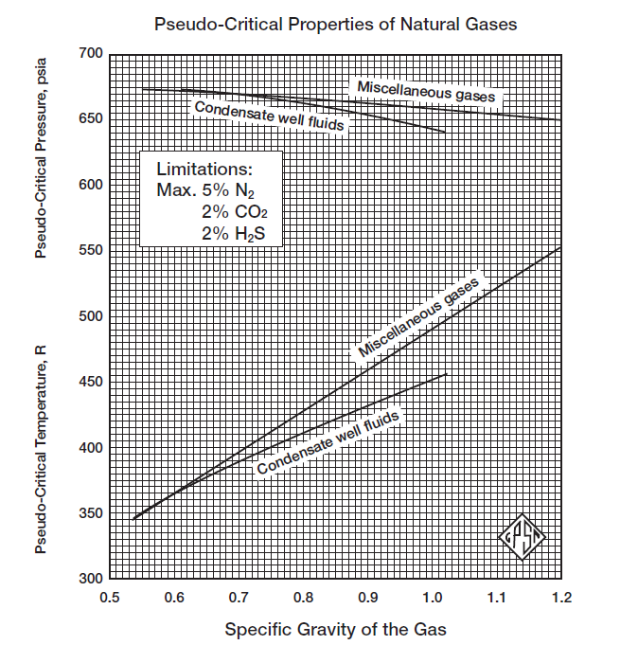

Slide 49

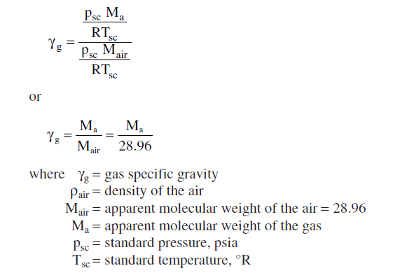
Example: Rework the last example to calulate the z-factor using the specific gravity method. 5min
Remember the specific gravity is defined as:

Slide 50
Problem-4 for the report
Note : use the two ways of finding the pseudo values

Slide 51
See you next time
Oppurtunity for the first groups: 2 or 3
Prepare a short presentation of 10 min
Choose a subject yourselves (related to the petroleum engineering, Reprot problems)
HAVE A NICE TIME

